Slide 1
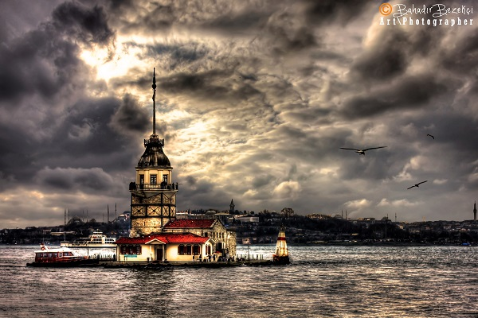
TRAVEL LESSON

Slide 2
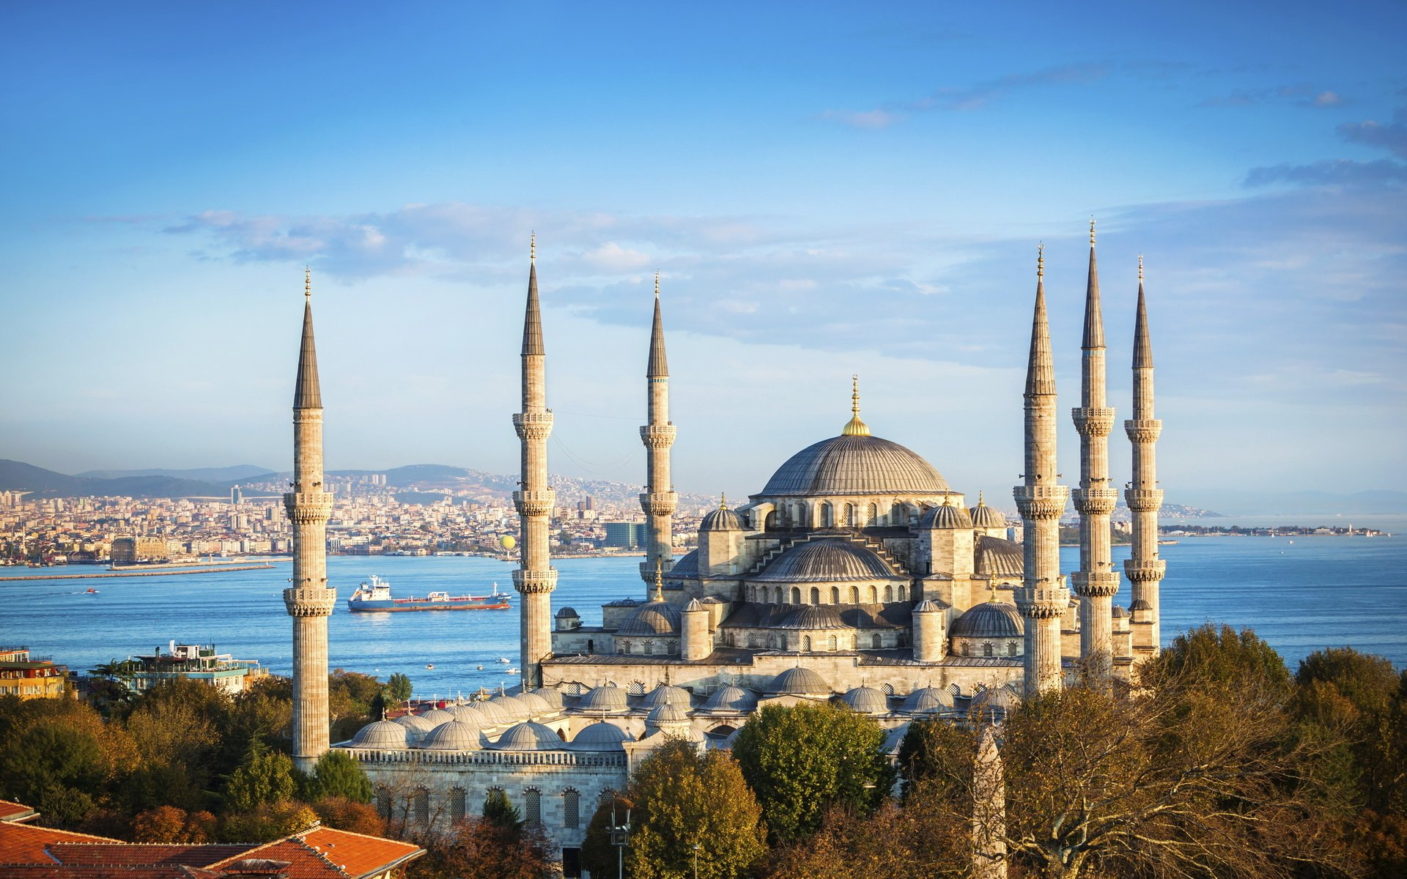
Travel lesson is very useful and entertaining for the students.Because they see different places in this lesson.The students are see and explore new places.They can go to the culturel trip with their teachers and they can ask a question to the their teachers and their teachers give the information for this trips.

Slide 3
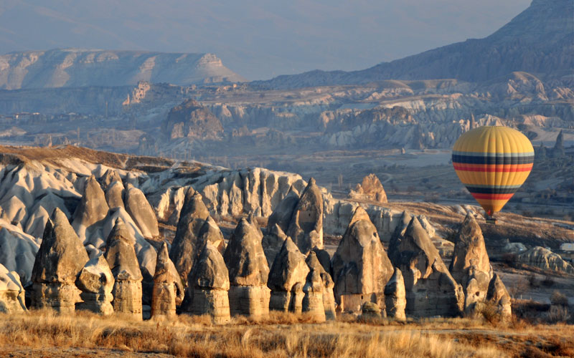
1.Culturel trip such as cappadocia;
Cappadocia is the best culturel trip place for the students.They can rent flying balloon and lead a life of pleasure for the amazing view.

Slide 4
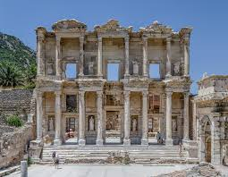
2.Culturel trip EFES Ancient City;
That place is in the Izmir.It is a city of culture.Because it is very old monuments.The students get very excited there.

Slide 5
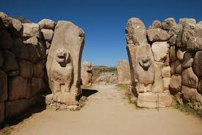
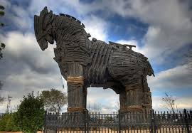
Sphinx Gate/ Truva Ancient City/Çanakkale
Alacahoyuk(ÇORUM)

Slide 6
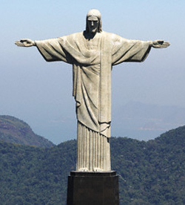
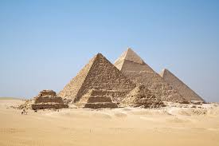
Christ Statue/Rio de Jenerio Egyptian Pyramids/Egypt
(Brasil)

Slide 7
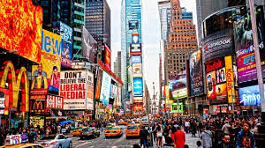
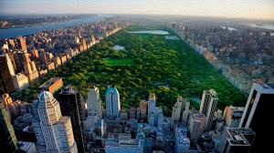
Times Square/NYC(USA) NYC Manhattan/USA

Slide 8
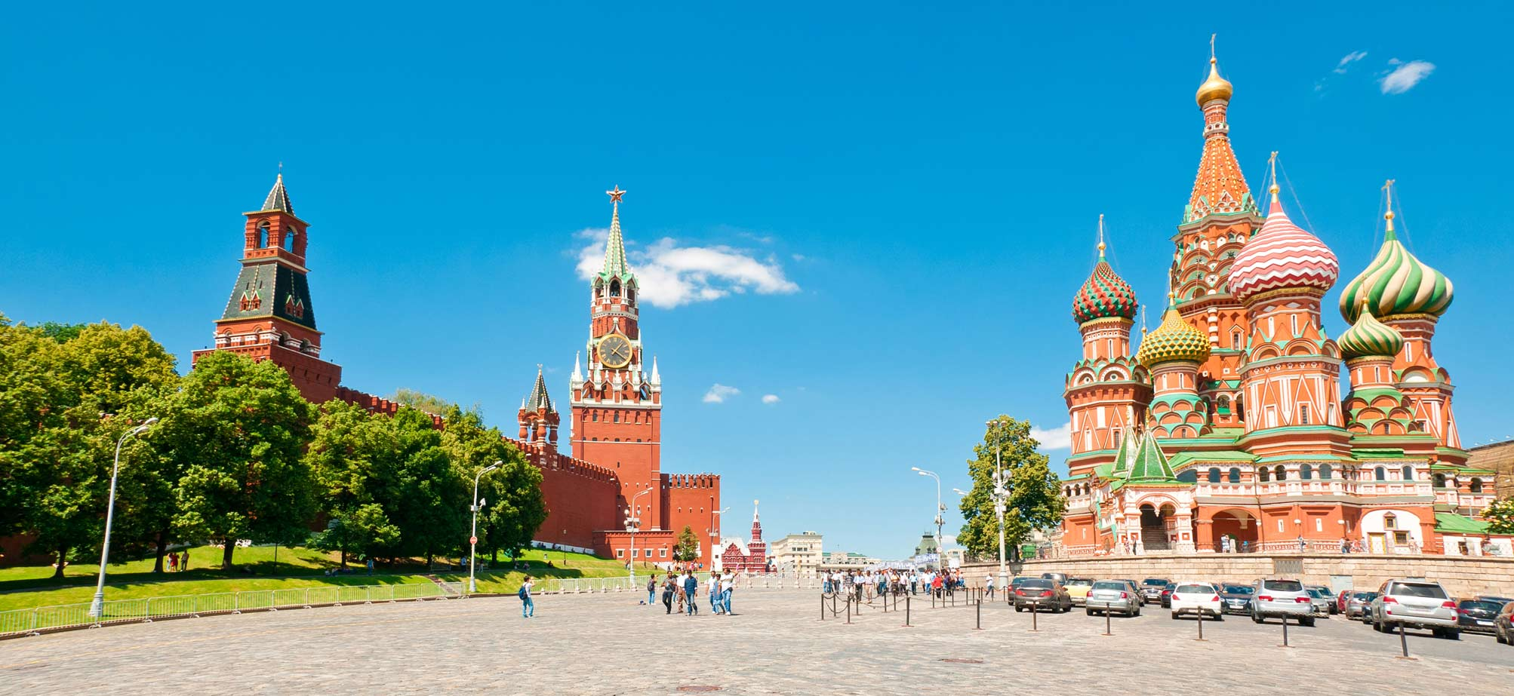
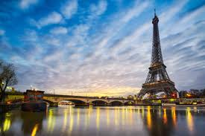
Disneyland/Russia Eiffel Tower/France

Slide 9
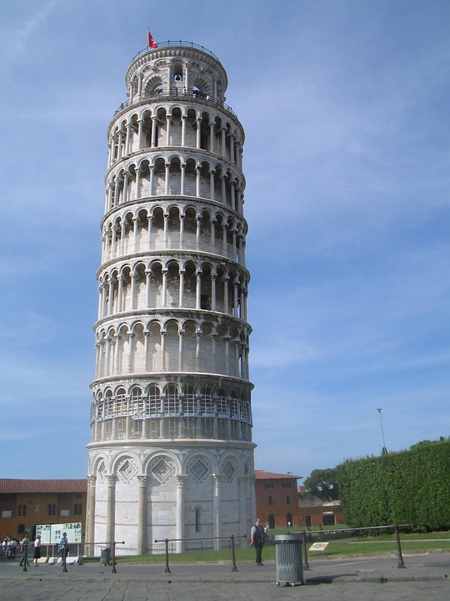
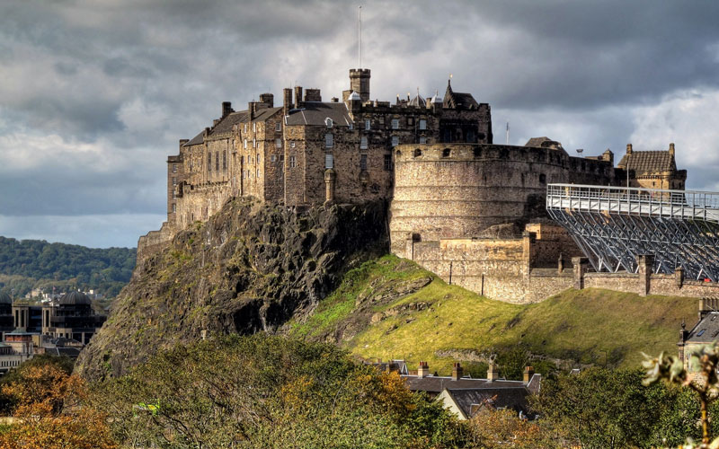
ooo
Pisa Tower/Italy Edinburgh Castle/Scotland

