Slide 1
INTERESTING LESSONS
BERFİN KELEŞ
10/C

Slide 2
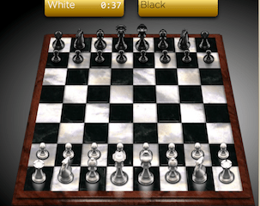
I WOULD LIKE TO HAVE MIND DEVELOPING GAMES LESSONS

Slide 3
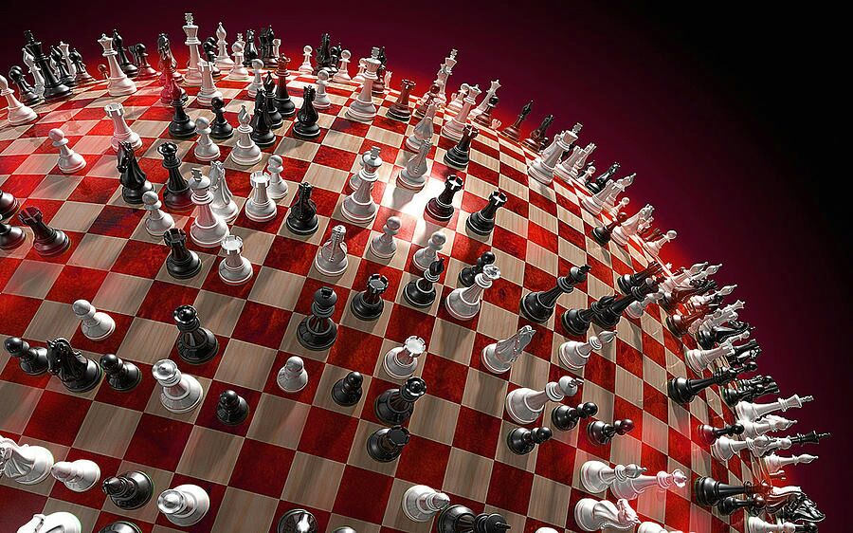
For example learn the chess advanced level and attend chess tournaments…

Slide 4
For example learn the do puzzle very well … VERY PERFECT..

Slide 6
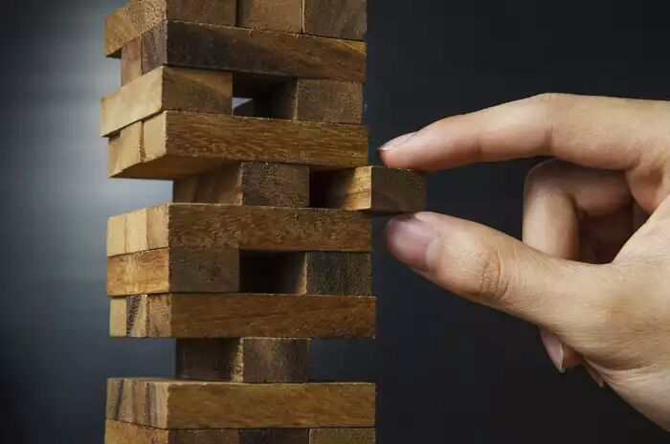
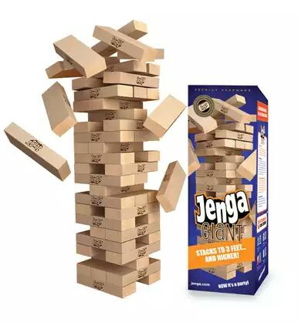

Slide 7
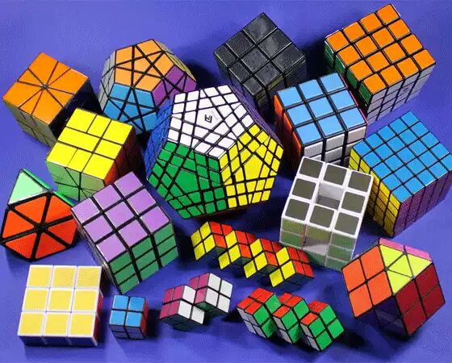
For example learn mechanical Rubik’s Cube . Thats very cool and perfect things….,,

Slide 8
FINISH……………,,,??

