Slide 1
ENGLISH WORK

Slide 2
~SCHOOL SUBJECTS~
There are classic subjects in my school. Subjets’ parts to numeral and verbal.

Slide 3
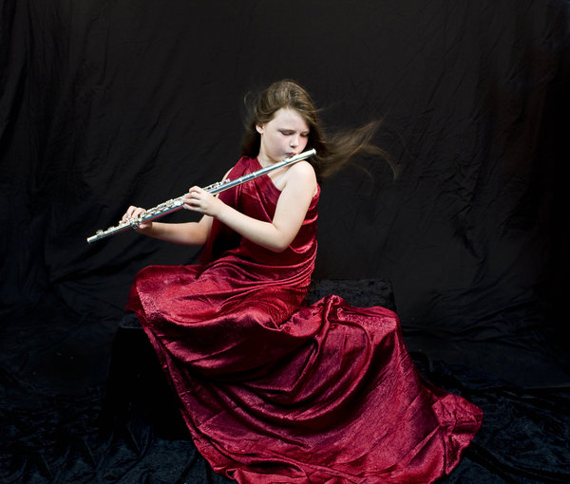
~SPECIAL SUBJECTS~
I want to have a more different subjects in my school. Like a playing instrument.. I can’t play an instrument professionally. But i want to make it so much.

Slide 4
For example i want to play the violin. Because playing violin wants a big ability. And the violin’s voice is awesome.

Slide 5
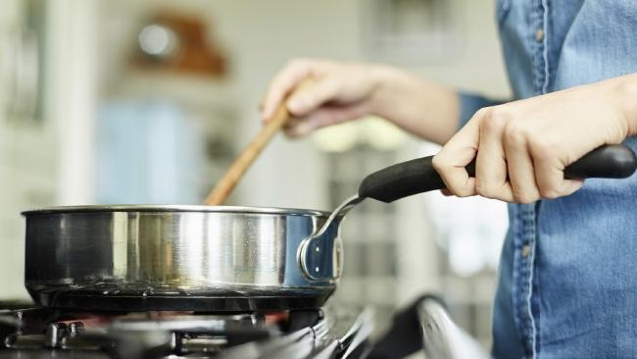
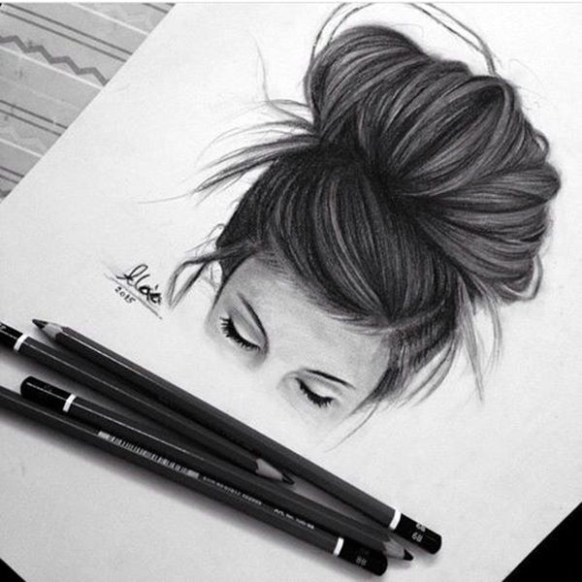
~ADVICES~
If we take instrument lessons ,we can get different hobbies.
It mustn’t be only instrument.. Special Lessons can be cooking, filming, drawing, driving, dancing...
To me, if these activities increase, we can love our school more much.

