Slide 1
ENGLISH POWERPOİNT HOMEWORK
NAME: BERAT
SURNAME: TİKEN
CLASS-NUMBER: 10/A-1395

Slide 2
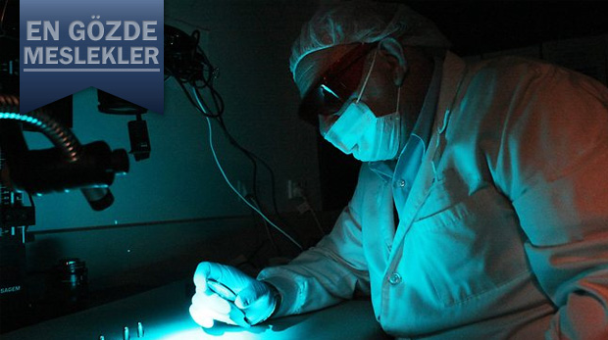
I would like to :
My favorite lessons biology, chemistry, physics.
I want to be forensic medicine expert. I want to see anatomy lesson in the school. It is a important lesson for the future job.

Slide 3
We examine the human body and organs. It’s a very important lesson about medicine. It is a very important lesson for me.

Slide 4
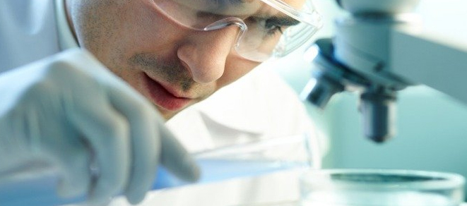
I'm very curious about this. My cousin studied medicine. I would like to study medicine. It’s mine big dream.

Slide 5
Thanks for listening.

