Slide 1
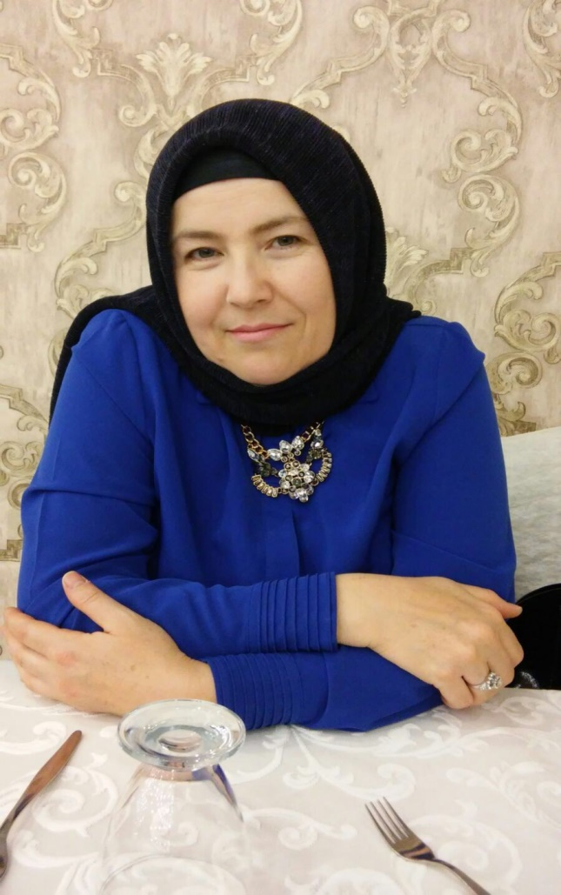
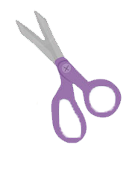
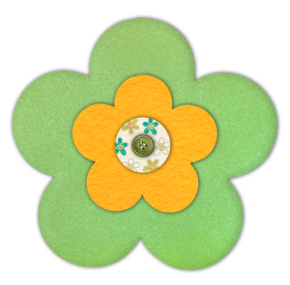
Name: Neziha Çolak
She is my mother.
She is a housewife.
She always makes houseworks like washing the dishes, cooking and cleaning.
She plays game on
the phone , knittes in her free time.

Slide 2
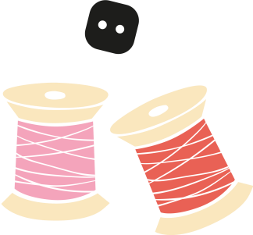
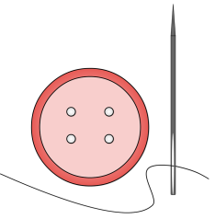
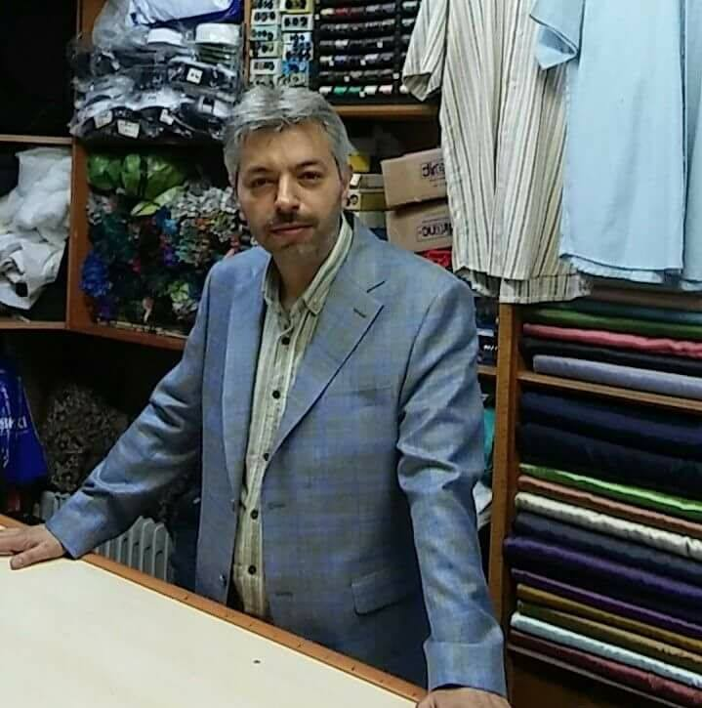
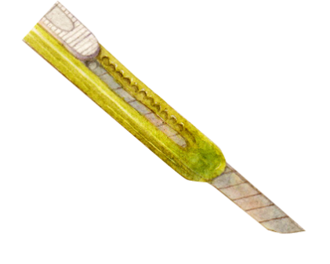
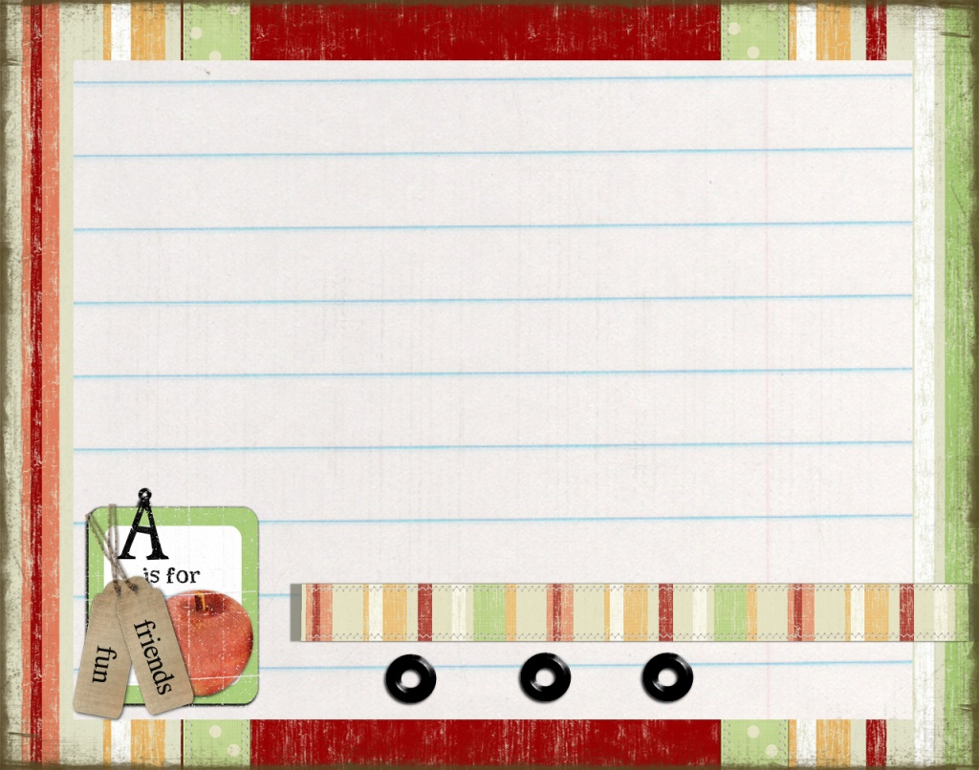
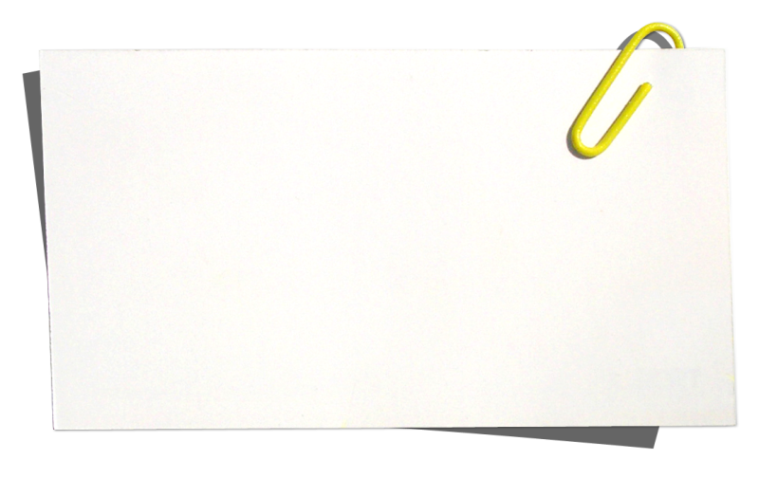
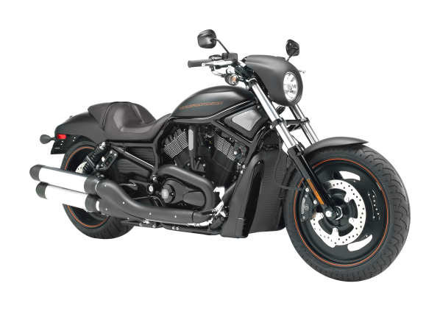
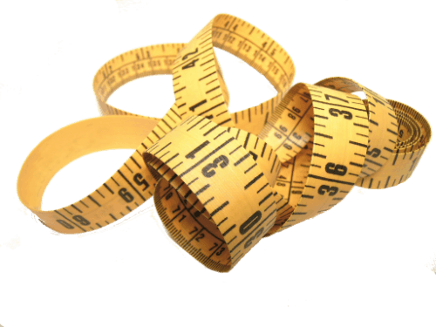
Name: Namık Kemal Çolak
He is my father. He is a tailor.
He drives motorcycle.
He sometimes leaves
me to school.
He likes watching
football matches.

Slide 3
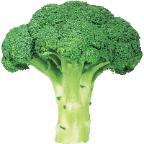
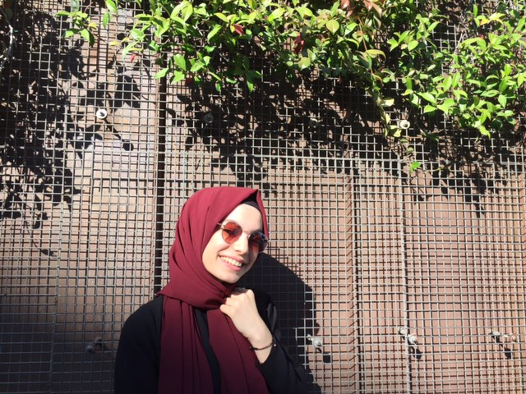
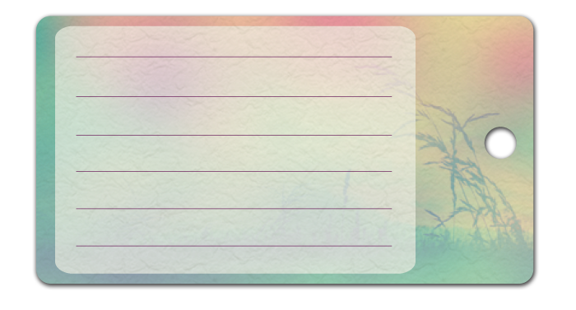
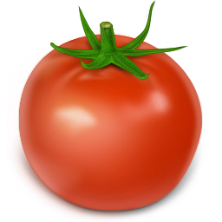
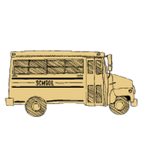
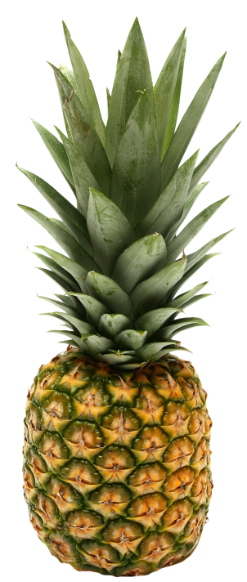
Name: Beyza Nur Çolak
She is my sister. She is 20 years old.
She is a Nutrition and Dietetic student in
the University.She likes watching series,
listening music and reading a lot of books!
She lives in Ümraniye but she is
staying in dorm because of her school .
She always
helps me
on my
homeworks♡

Slide 4
My mother’s family is so big!
I have got too many
Cousins from my
mother’s side.
I have got four aunts.
Semra
Eser
She is a religion teacher.
She lives in Başakşehir.
She has got a daughter and son. She is a hygiene patient so she likes
cleaning. She always talks on the phone with my mother.
Esra
Kavalcı
My mom!
♡
Zeliha
Kuyucu
Hatice
Aktaş
She works in the bank. She lives in Küçükköy.
She likes travelling
different countires and eating food!
She is a housewife.
She lives in Kağıthane.
She is the biggest sister.
She has got three sons.
She likes cooking, shopping and watching TV.
She is a housewife.
She has got two sons and
one daughter. She lives in
Esenyurt.
She likes talking on the phone.
She is watching Diriliş Ertuğrul in these days.

Slide 5
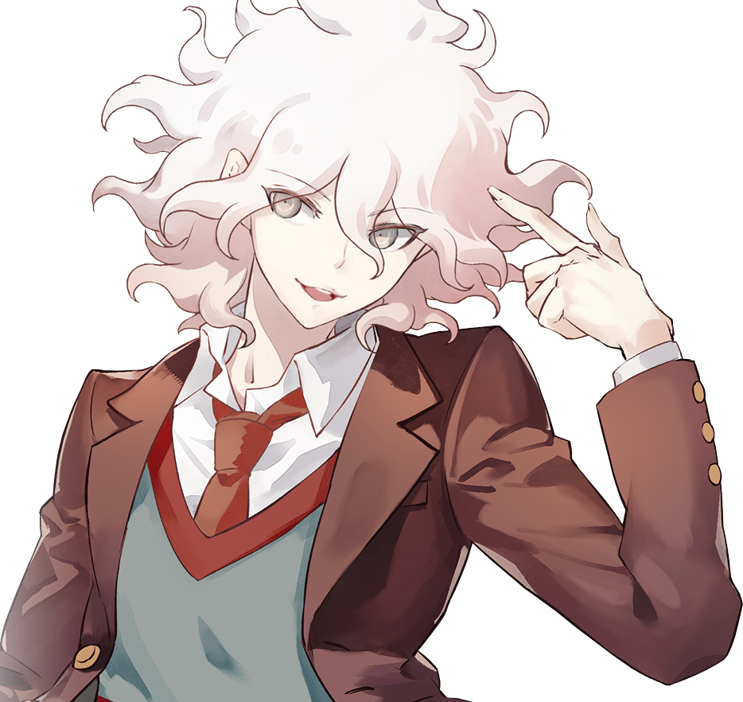
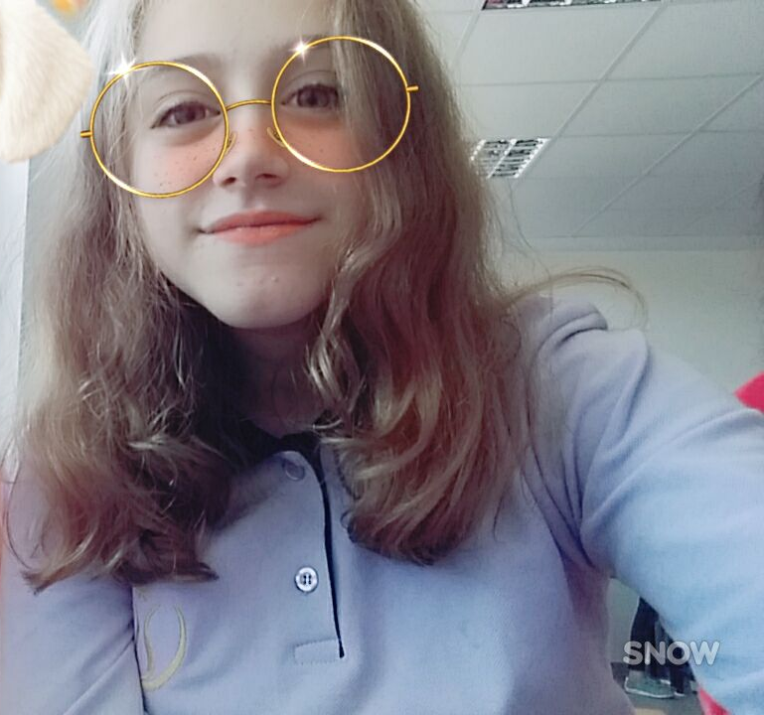
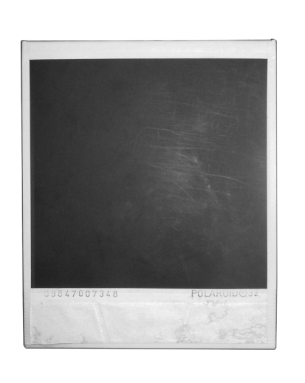
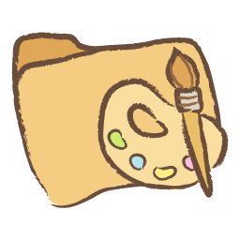
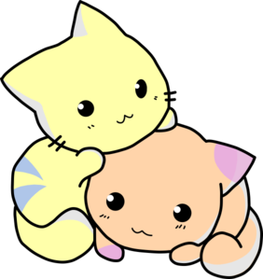
Name: Melike Aktaş
She is my favorite cousin. She is my Hatice aunt’s daughter.
She is going to Middle School in Başakşehir
right now. She wants to be Graphic Designer
She likes watching anime, playing video
games and drawing.
No
game,
No
life!

Slide 6
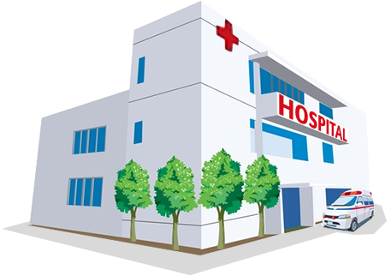
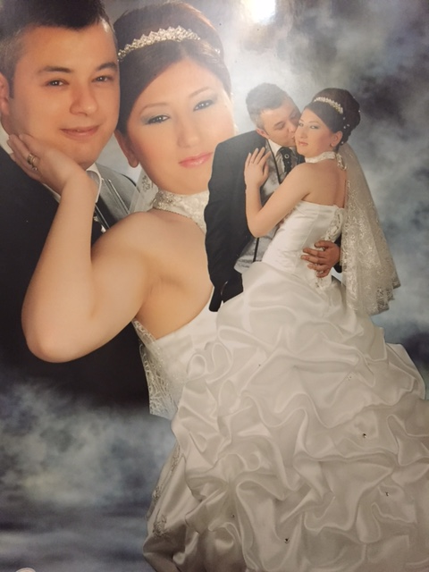
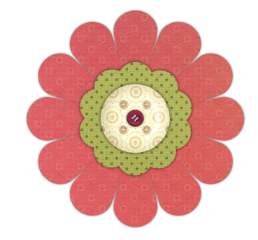
They are my aunt and uncle. They have got two sons. They live in Ümraniye.
Name: Senem Çolak
She is my aunt.
She is a housewife.
She likes watching TV
and shopping.
She leaves her
children to school.
Name: Fuat Çolak
He is my uncle.
He works in the hospital.
He likes playing football
And watching football maches.
Notes:
vsa

Slide 7
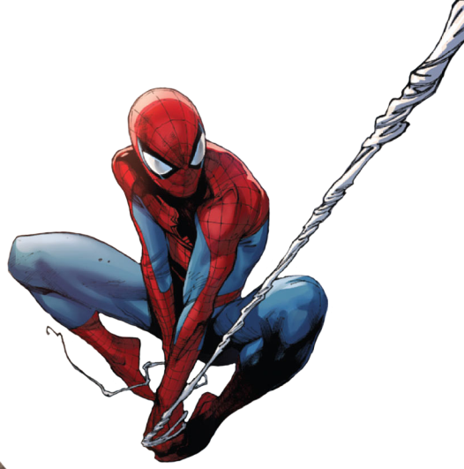
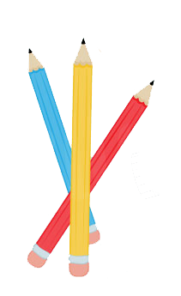
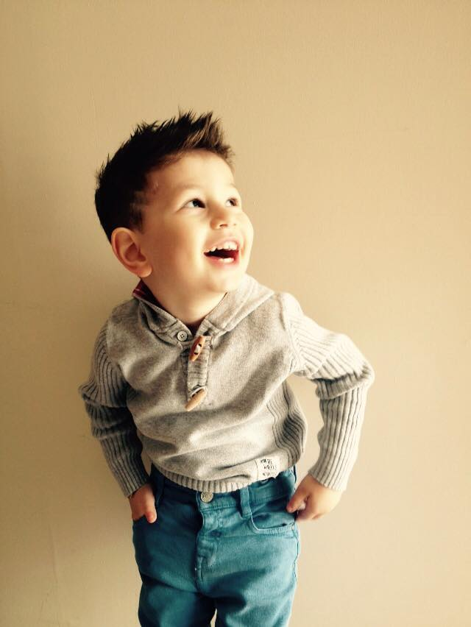
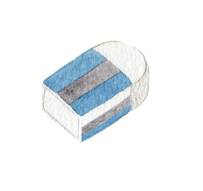
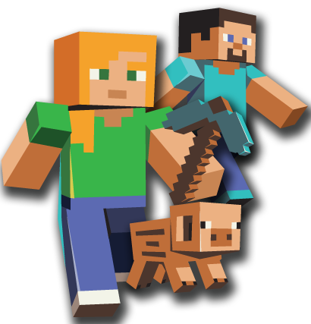
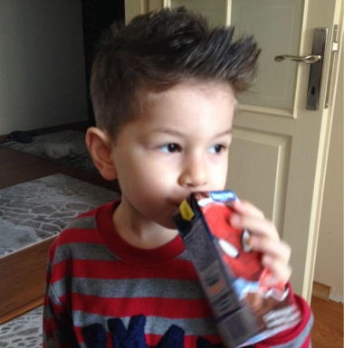
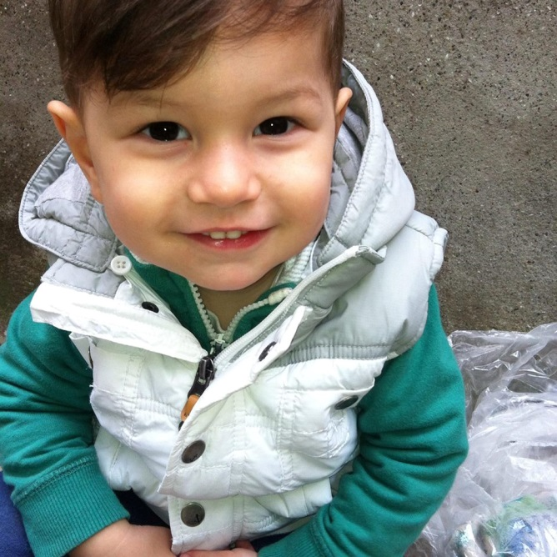
Name: Kerem Cemil Çolak
He is my uncle’s son.
He is going to junior school right now. He likes playing games like Minecraft.
He watches videos from Youtube and does his homework everyday.

