Slide 1
MY FAMILY’S ROUTINES

Slide 2
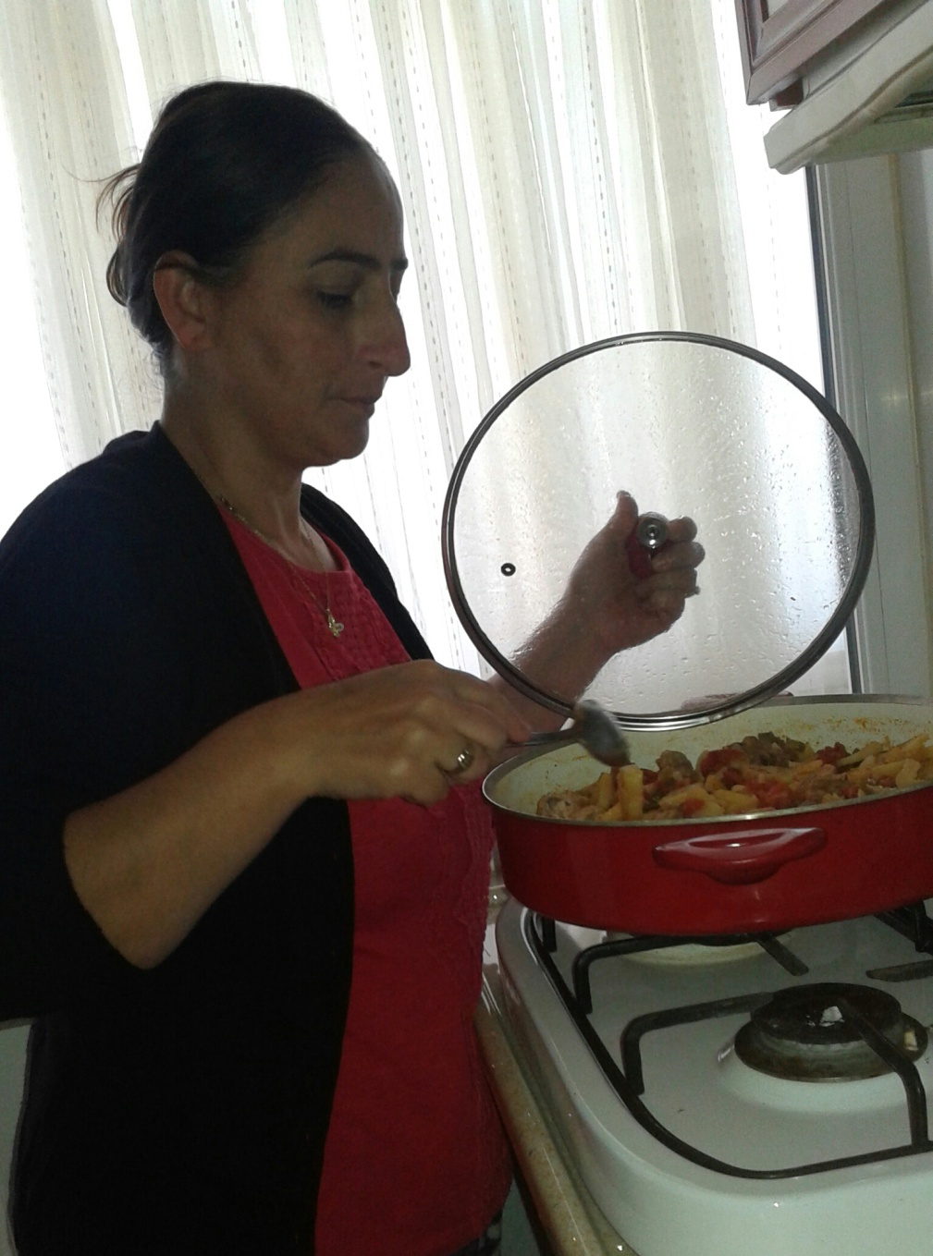
My mother is cooking some food for dinner.

Slide 3
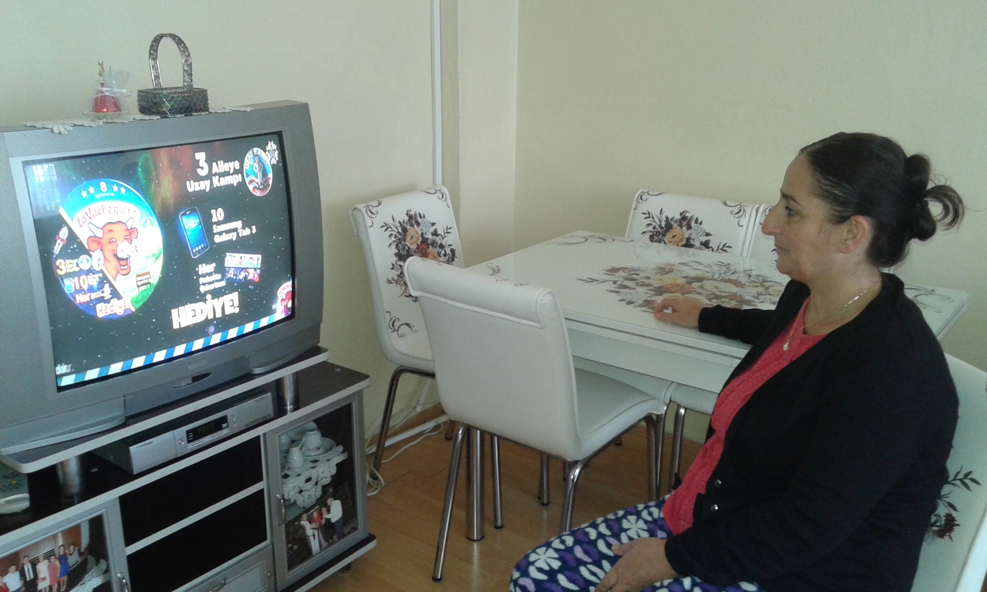
She is watching TV.

Slide 4
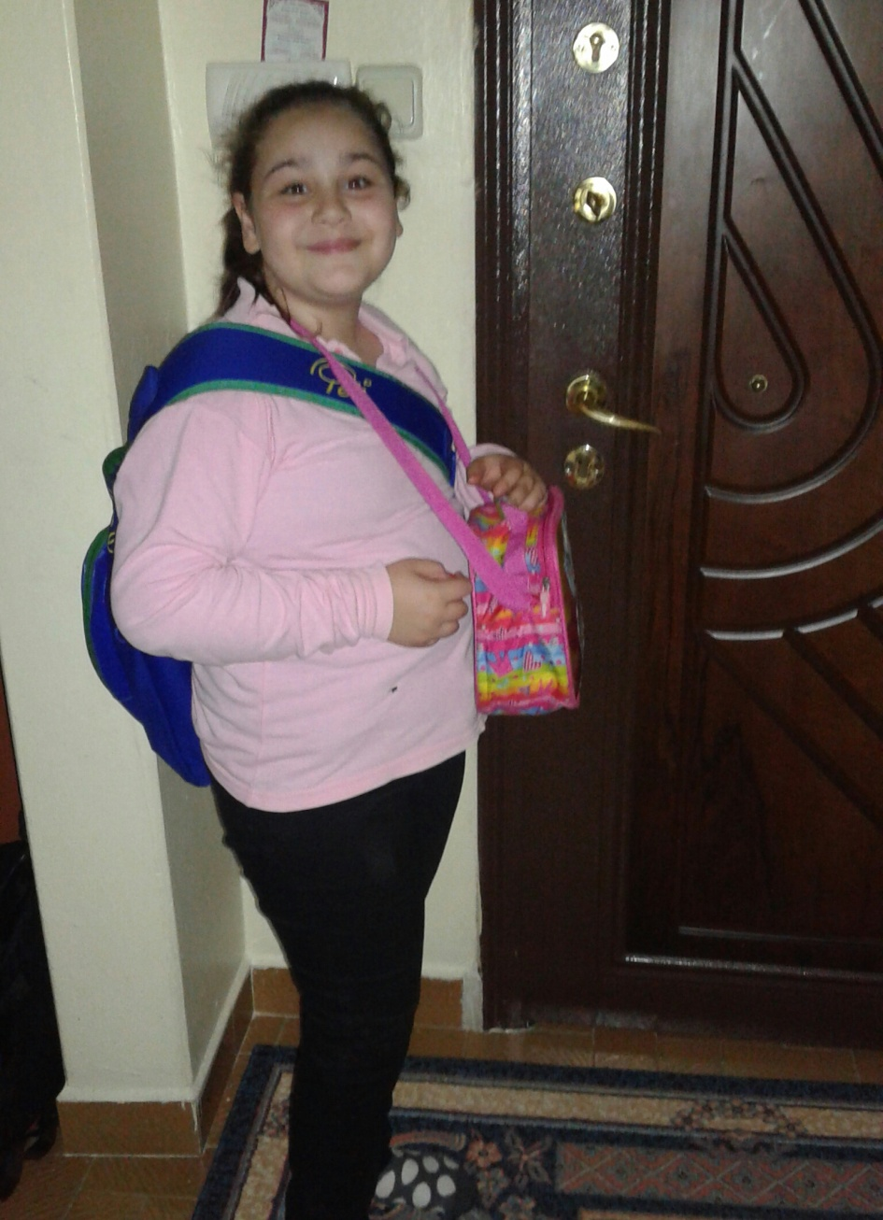
My sister is going to school.
She wears school uniform on weekdays.

Slide 5
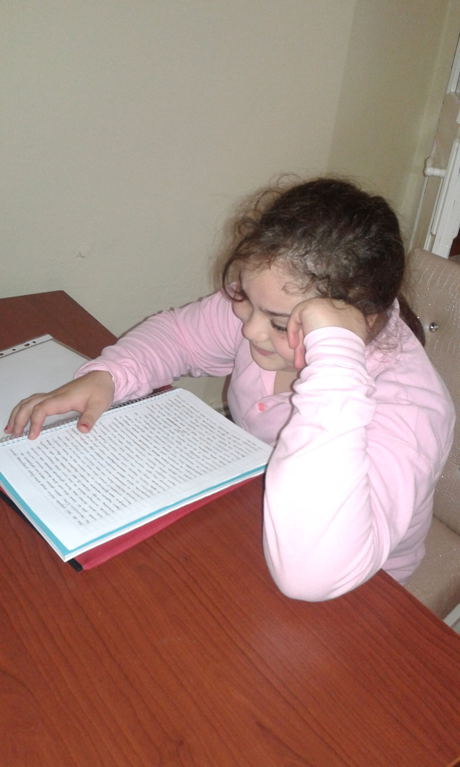
She is studing for an exam.

Slide 6
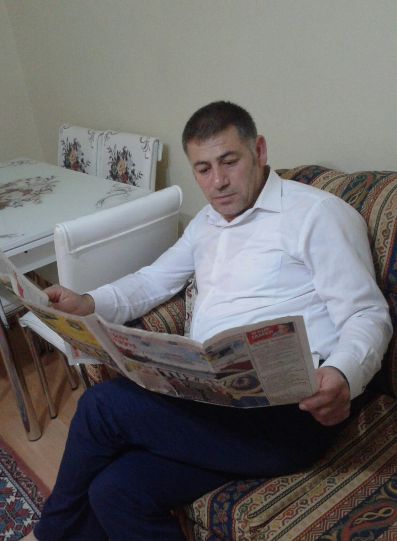
My father reads a newspaper every day.

Slide 7
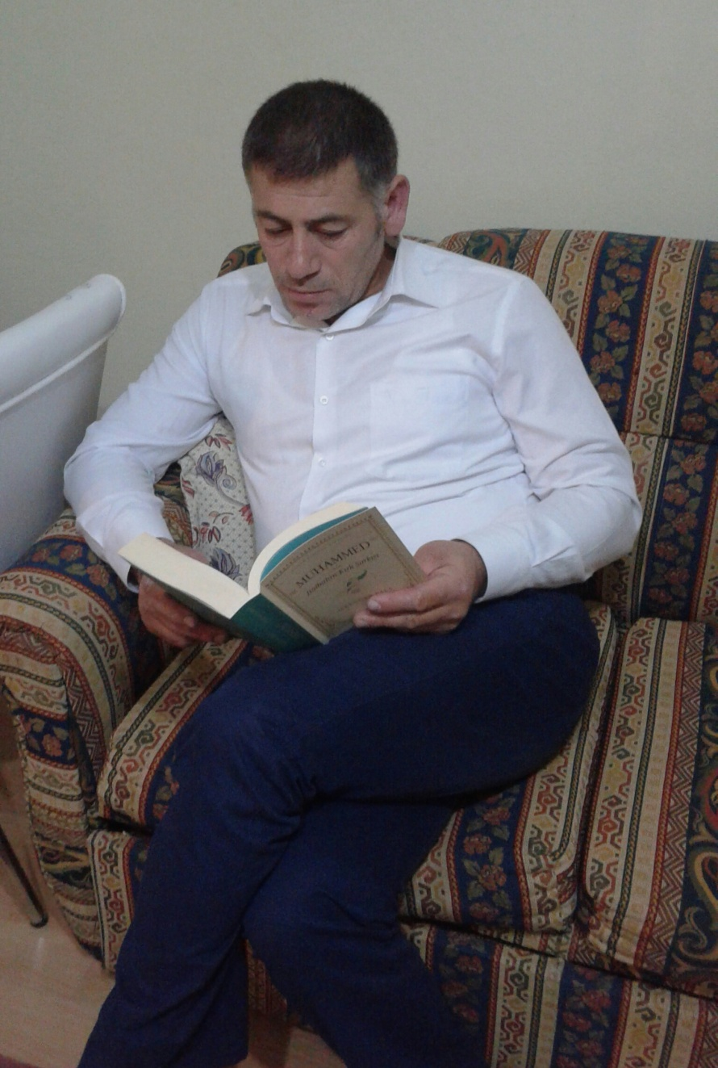
He usually reads a book in his spare time.

Slide 8
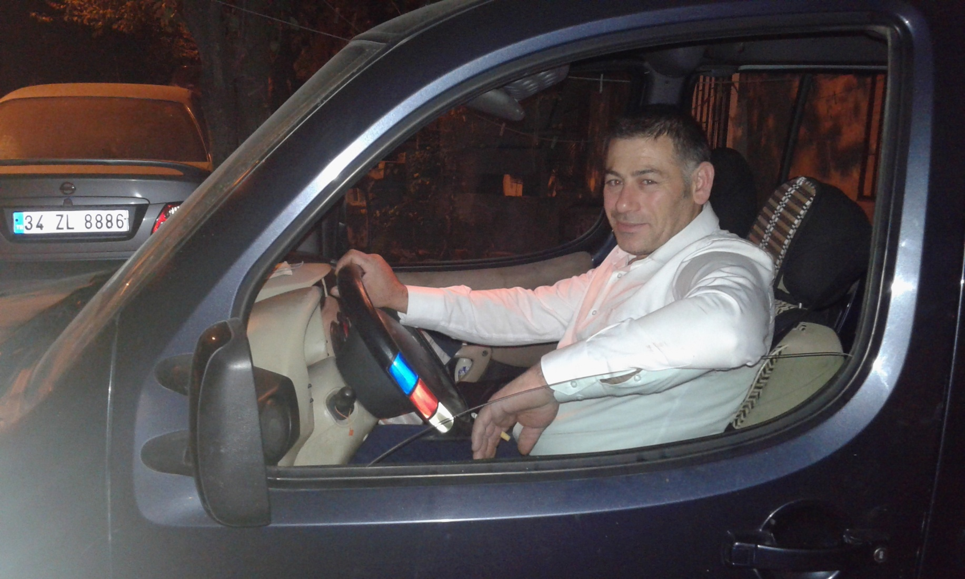
He is driving a car these days.

Slide 9
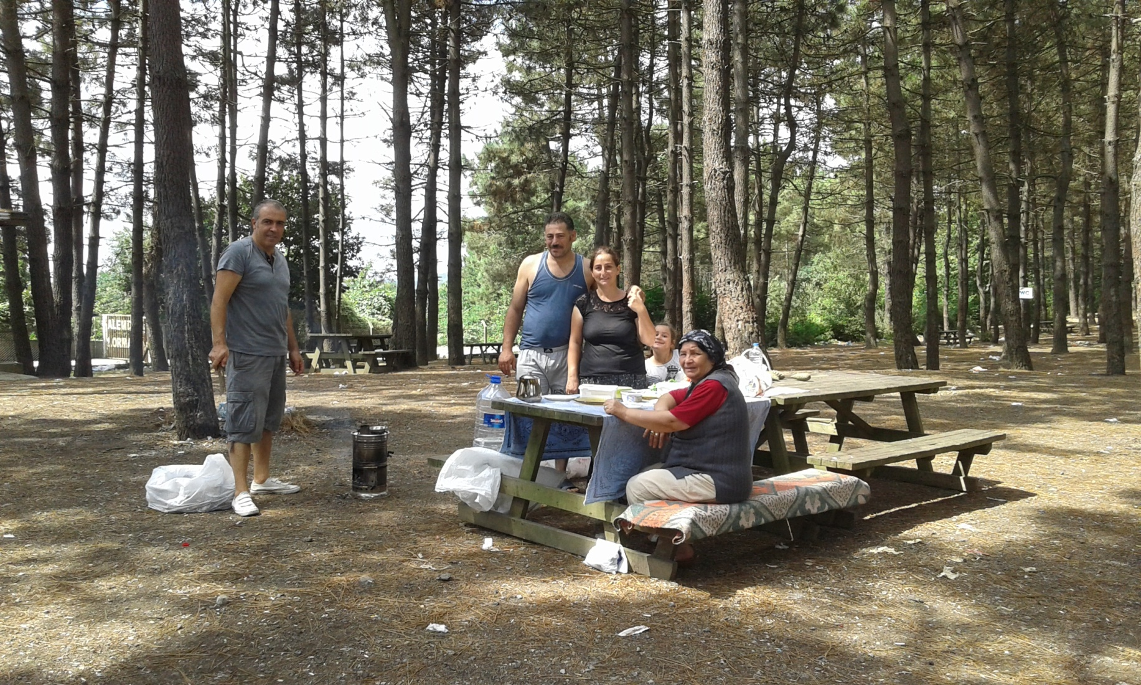
They go picnic every Sunday.

Slide 10
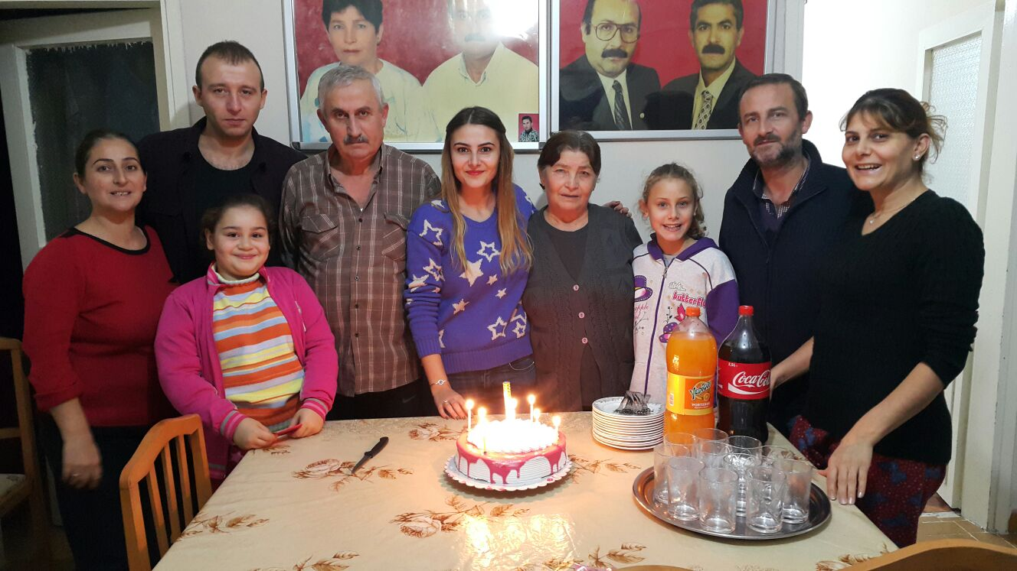
We visit to relatives every Saturday.

Slide 11
Sevda Destegül
1533 10C

